Slide 1
Quadratic Functions Review

Slide 2
Q1: How many of the following functions are quadratic?
II only b) ii and III c) iii and iv only
d) Ii, iii, and iv d) all one of them except i

Slide 3
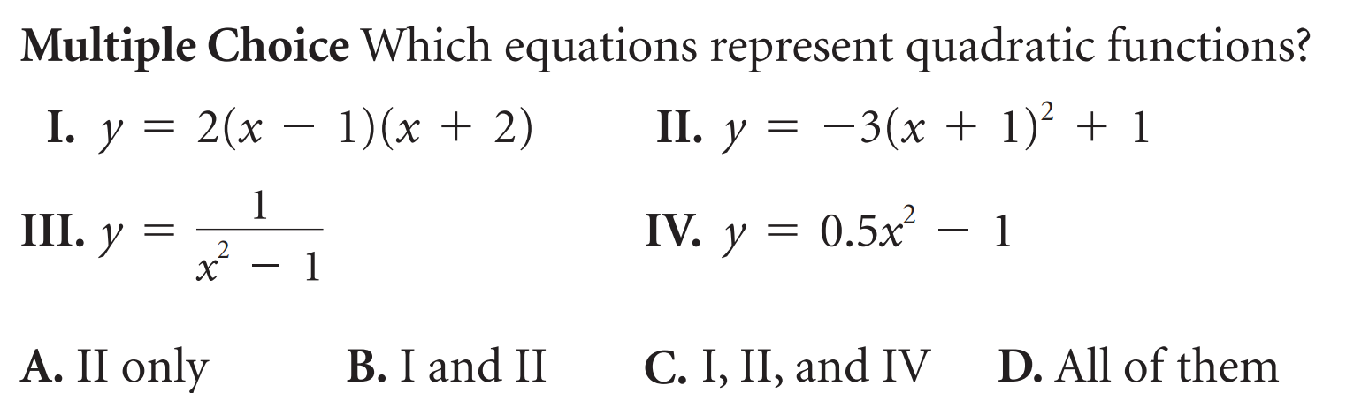

Slide 4
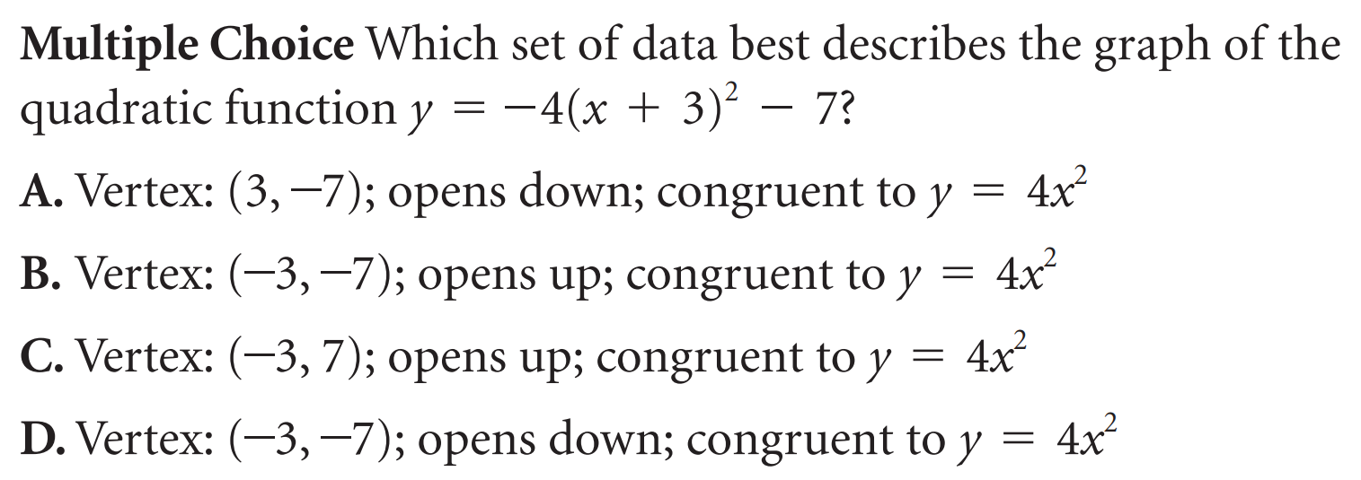

Slide 5
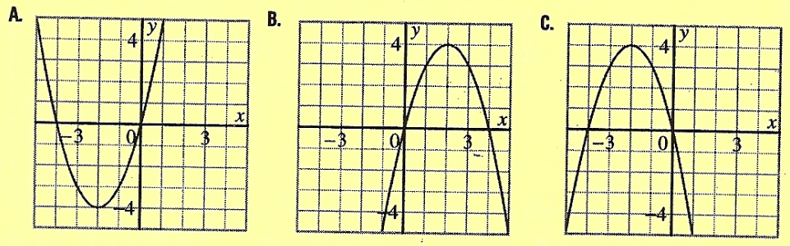
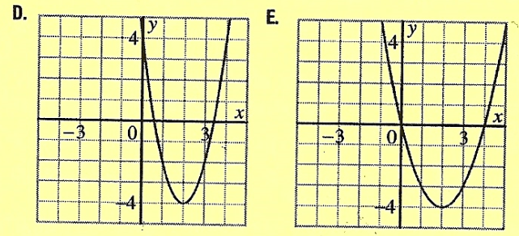
Which of the following has a minimum of (2,-4) with a=2?

Slide 6
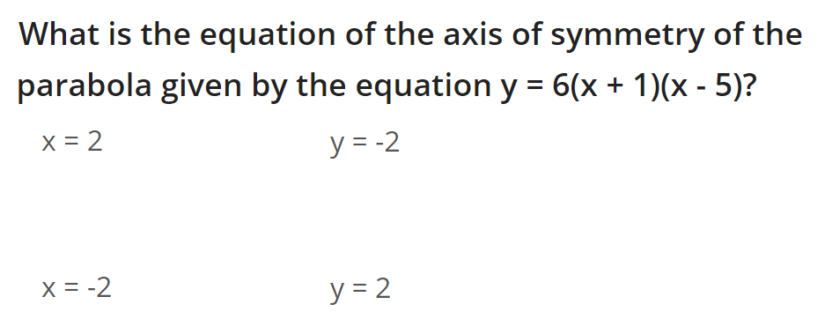
A)
B)
C)
D)

Slide 7
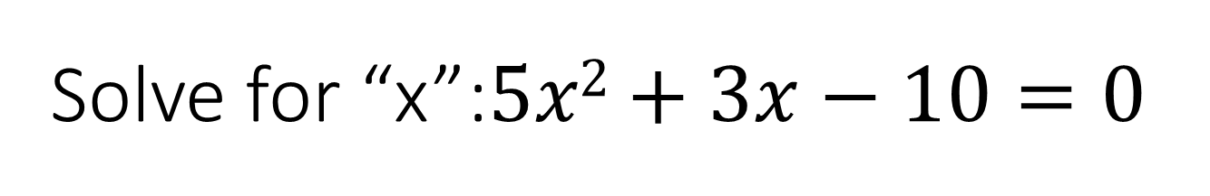
Solve for “x”:$5x2+3x−10=0$

Slide 8
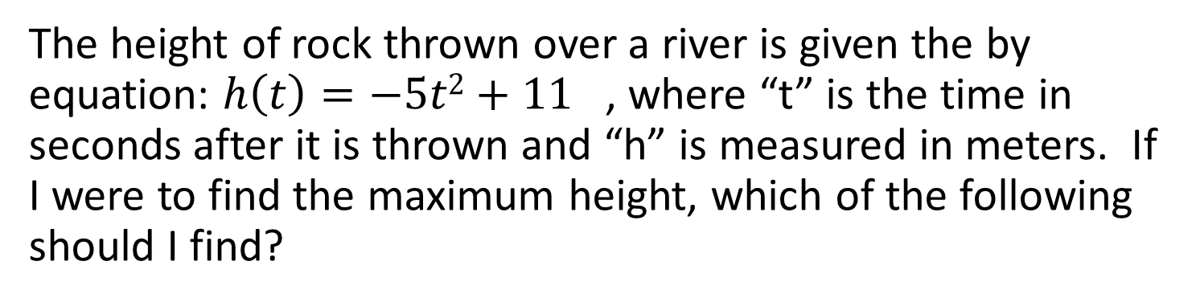
The height of rock thrown over a river is given the by equation: $h\left(t\right)=−5t2+11$ , where “t” is the time in seconds after it is thrown and “h” is measured in meters. If I were to find the maximum height, which of the following should I find?
The X-intercepts because they indicate when the height will be zero
The axis of symmetry b/c that is when the max height occurs
The y-intercept b/c it indicates what the original height is
The y-coordinate of the vertex b/c that is the highest point on the graph
The domain of the function b/c it will give us the maximum height

Slide 9
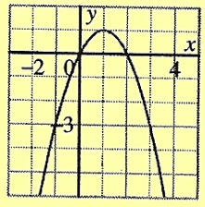
Which equations describes the parabola shown?

Slide 10
If one x-intercept of a parabola is at (-10,0) and the vertex is at (2,13), which one of the following is the other x-intercept?
(10,0) b) (13,0) c) (20,0) d(2,0) e(14,0)
f) It is impossible to find the other x-intercept without knowing the equation

Slide 11
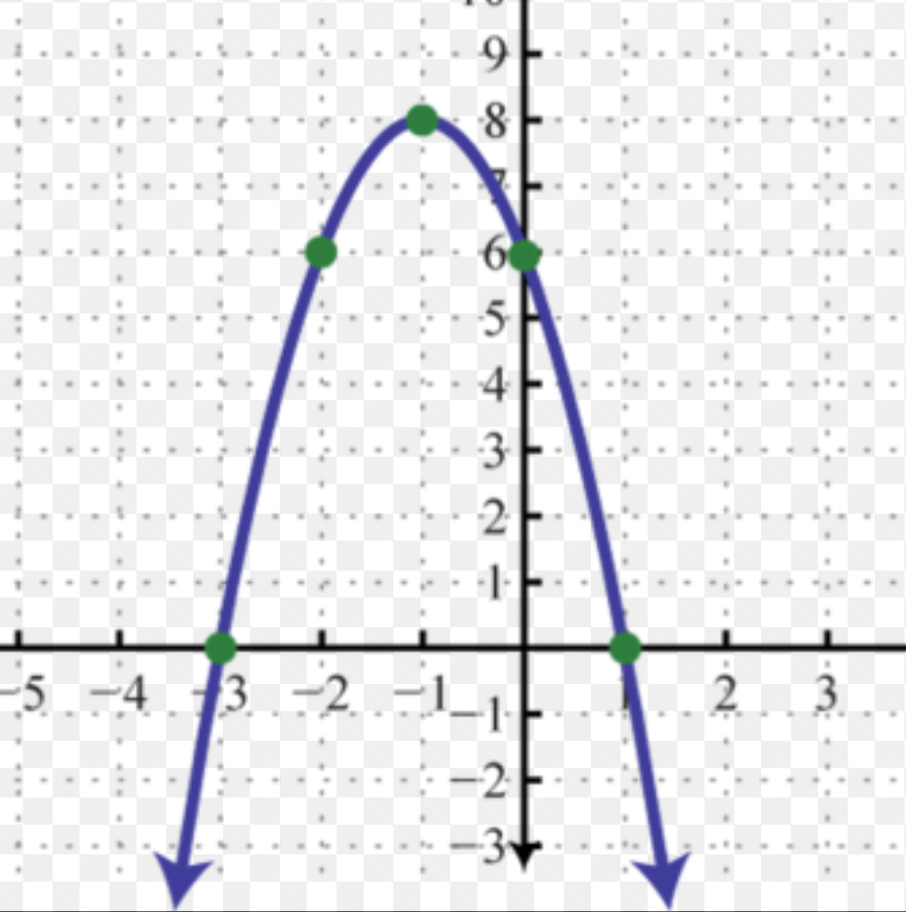
A student was asked to graph a parabola with the function provided and then to label the vertex, axis of symmtrey, X and Y intercepts. The submitted work is shown below: What is missing from the student’s work?

Slide 12
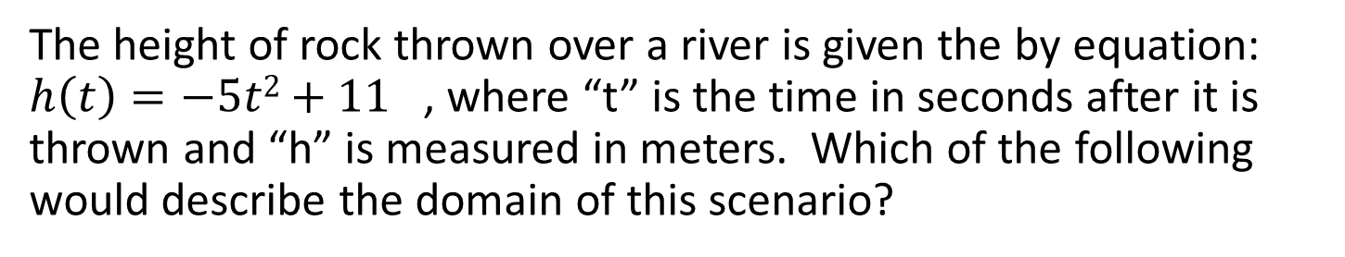
The height of rock thrown over a river is given the by equation: $h\left(t\right)=−5t2+11$ , where “t” is the time in seconds after it is thrown and “h” is measured in meters. Which of the following would describe the domain of this scenario?
The time it takes to get to the maximum height
The time between when the rock is thrown to when it hits the ground
The time from when it is thrown
The height of the rock from 0 to the maximum height
The domain includes the realm of all existence to which scenario has occurred

Slide 13
The table of values is given. Which equation does it belong to?

Slide 14
The vertex of a parabola is at (10,3) with y-intercept at (0,8). What is the equation of the parabola?

Slide 15
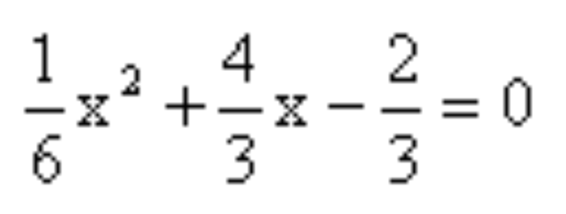
Solve for “x”:

Slide 16
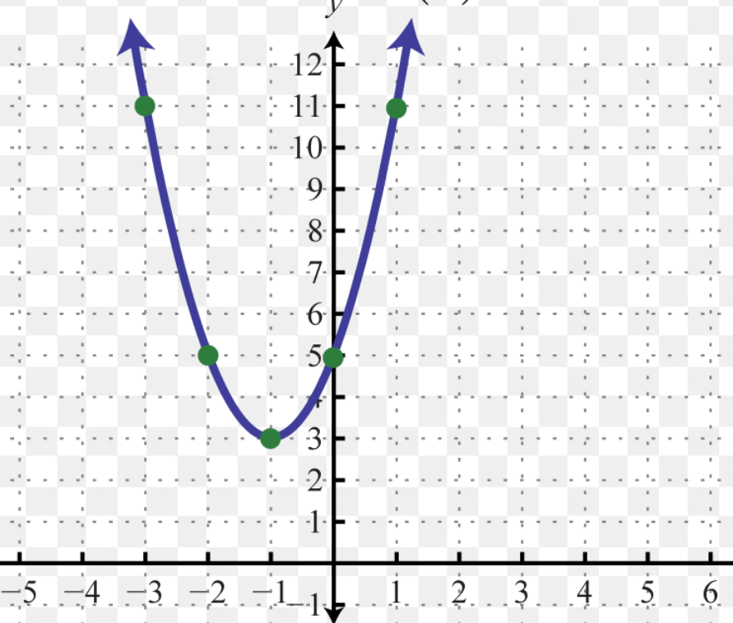
What is the equation of this parabola?

Slide 17
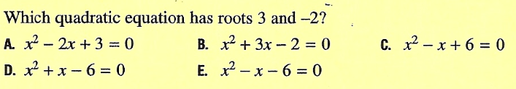

Slide 18
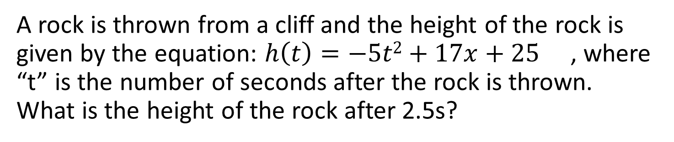
A rock is thrown from a cliff and the height of the rock is given by the equation: $h\left(t\right)=−5t2+17x+25$ , where “t” is the number of seconds after the rock is thrown. What is the height of the rock after 2.5s?
a) -88.75m b) 47m c) 39m d) 36.25m e) 223.75m

Slide 19
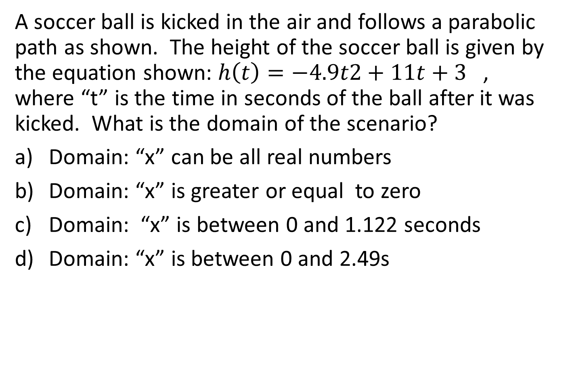
A soccer ball is kicked in the air and follows a parabolic path as shown. The height of the soccer ball is given by the equation shown: $h\left(t\right)=−4.9t2+11t+3$ , where “t” is the time in seconds of the ball after it was kicked. What is the domain of the scenario?
Domain: “x” can be all real numbers
Domain: “x” is greater or equal to zero
Domain: “x” is between 0 and 1.122 seconds
Domain: “x” is between 0 and 2.49s

Slide 20
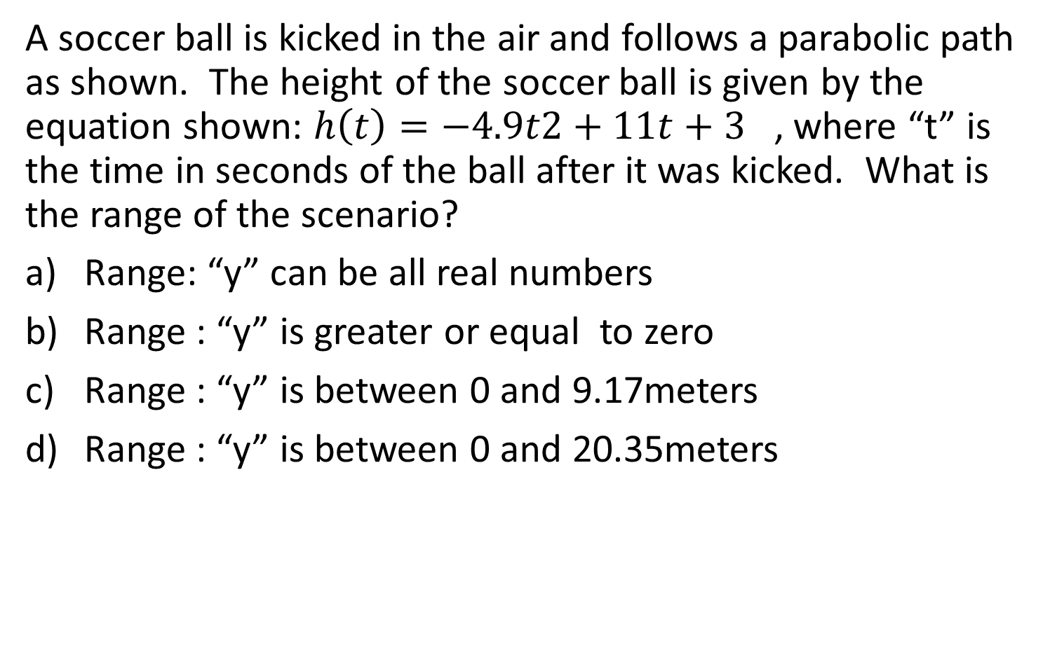
A soccer ball is kicked in the air and follows a parabolic path as shown. The height of the soccer ball is given by the equation shown: $h\left(t\right)=−4.9t2+11t+3$ , where “t” is the time in seconds of the ball after it was kicked. What is the range of the scenario?
Range: “y” can be all real numbers
Range : “y” is greater or equal to zero
Range : “y” is between 0 and 9.17meters
Range : “y” is between 0 and 20.35meters

Slide 21
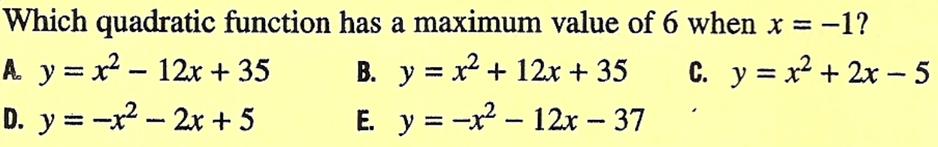

Slide 22
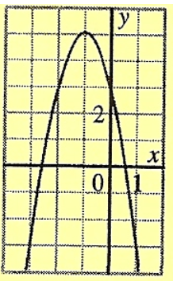
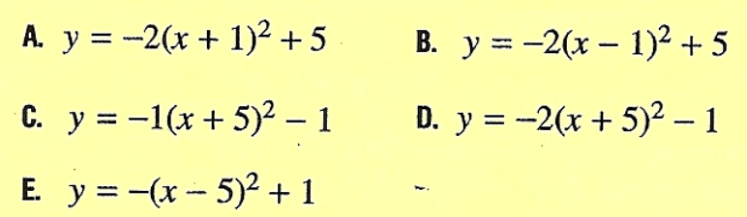

Slide 23


Slide 24
How many x-intercepts does the following function have?
a) Three x-intercepts, two are positive and one of them is negative
b) There are two x-intercepts and both are negative values
c) There are two x-intercepts and one of them is negative and the other is positive
d) There is only one x-intercept b/c the vertex is on the x-axis
e) There are no x-intercepts

Slide 25
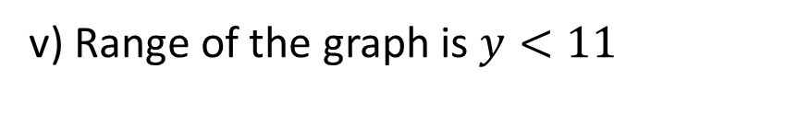
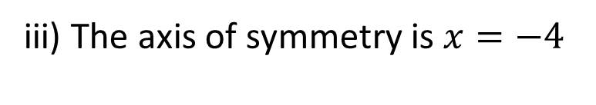
Given the equation below, Indicate true or false for each of the following statements:
i) The graph opens up
ii) The graph has two x-intercepts
iii) The axis of symmetry is $x=−4$
iv) The y-intercept of the graph is 11
v) Domain of the graph is all real numbers
v) Range of the graph is $y<11$

Slide 29
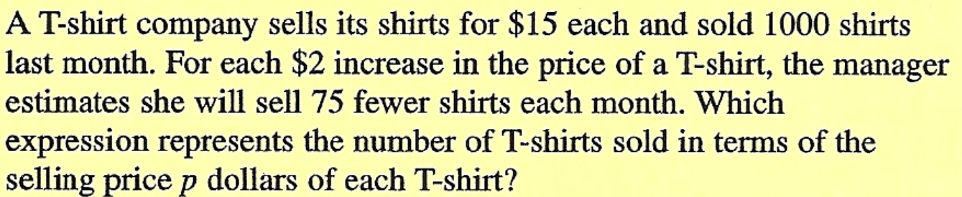

Slide 30


Slide 31
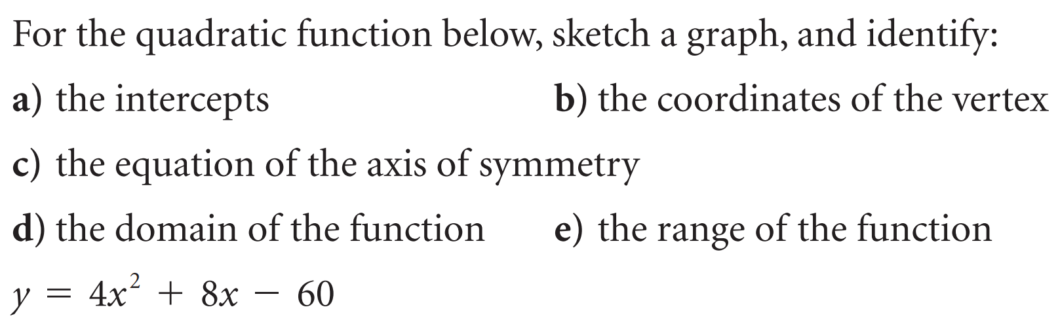
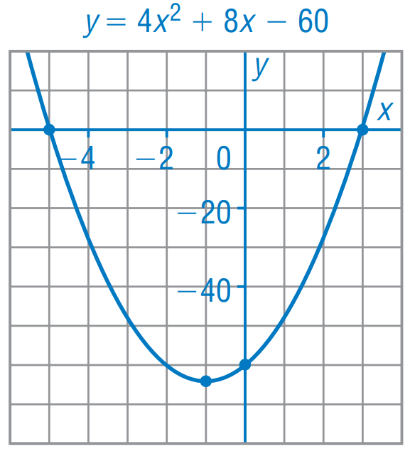
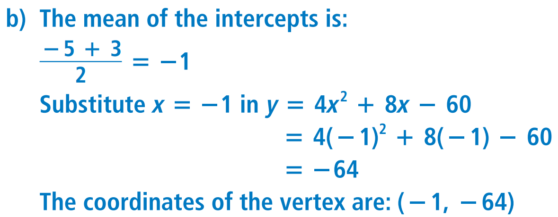
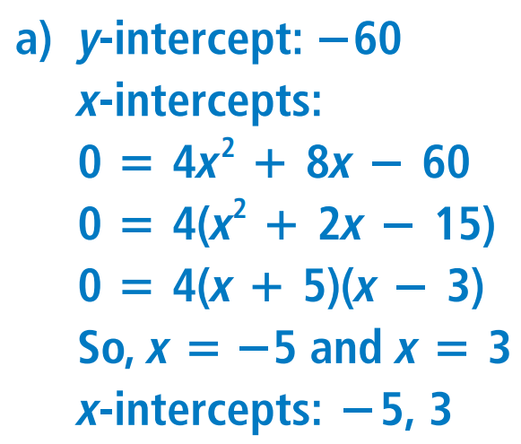
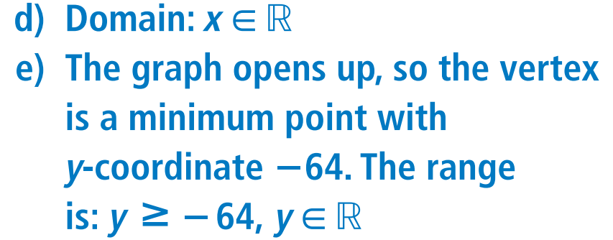

Slide 32
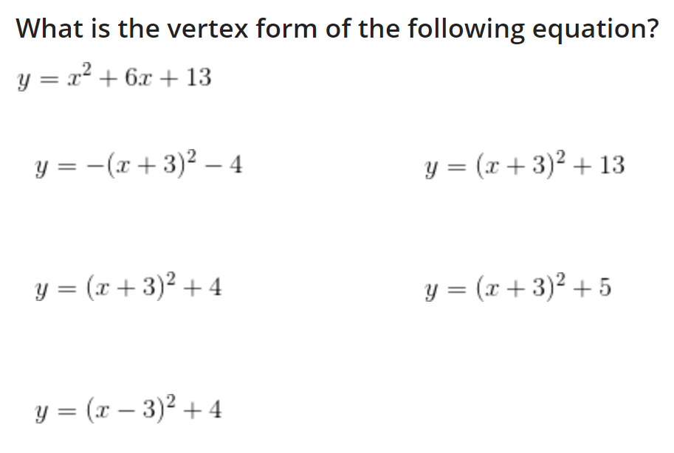
A)
D)
B)
E)
C)

